Slide 1
PART 3 Applying Your Testing Skills

Slide 2
Agenda

Slide 3
V. Chapter 12. Testing the Documentation
1. Types of Software Documentation
2. The Importance of Documentation Testing
3. What to Look for When Reviewing Documentation
4. The Realities of Documentation Testing

Slide 4
V. Chapter 12. Testing the Documentation
1. Types of Software Documentation
  Packaging text and graphics
  Marketing material, ads, and other inserts.
  Warranty/registration.
  EULA
  Labels and stickers
  Installation and setup instructions
  User's manual
  Online help
  Tutorials, wizards, and CBT (Computer Based Training)
  Samples, examples, and templates
  Error messages

Slide 5
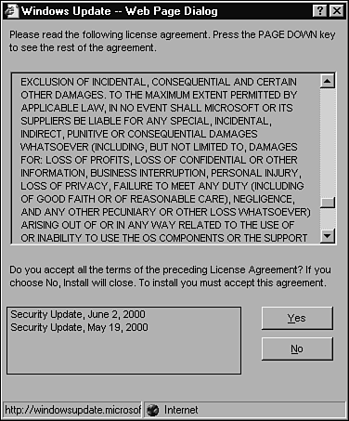

Slide 6
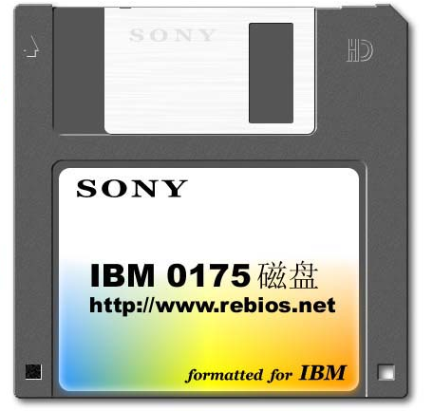
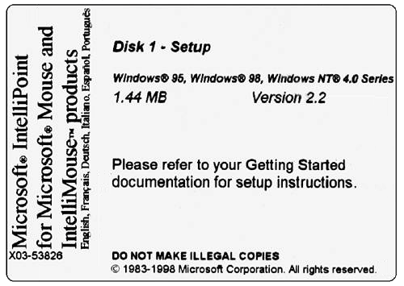

Slide 7
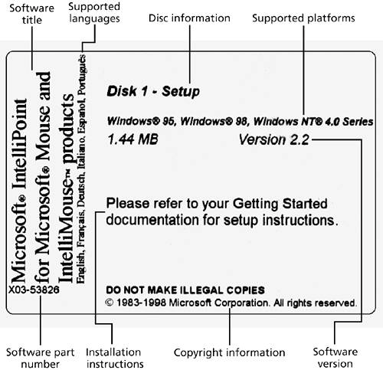

Slide 8
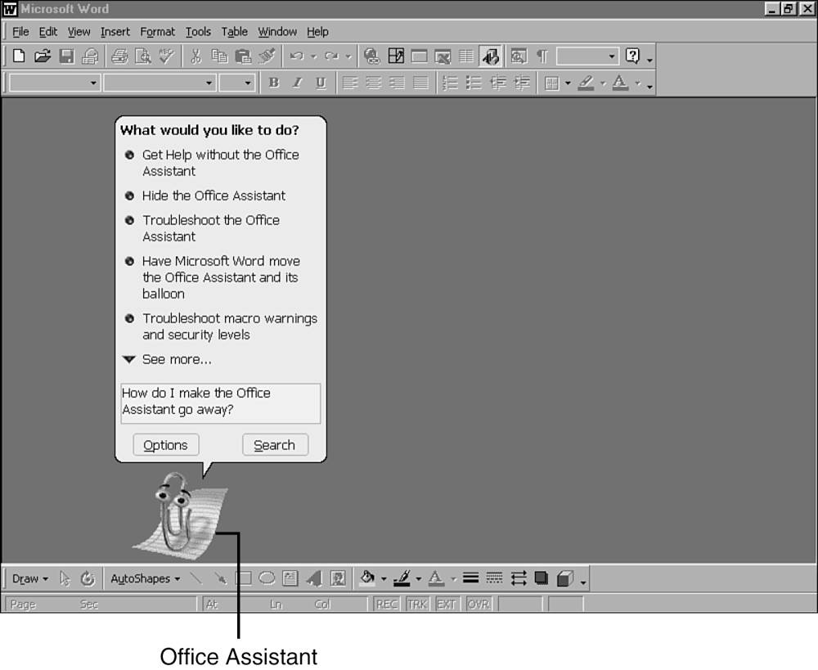

Slide 9
V. Chapter 12. Testing the Documentation
2. The Importance of Documentation Testing
Good software documentation contributes to the
product's overall quality in three ways:
  It improves usability
  It improves reliability
  It lowers support costs

Slide 10
V. Chapter 12. Testing the Documentation
3. What to Look for When Reviewing Documentation
checklist

Slide 11
V. Chapter 12. Testing the Documentation
4. The Realities of Documentation Testing
  Documentation often gets the least attention, budget, and resources.
  It's possible that the people writing the documentation aren't experts in what the software does.
  Printed documentation takes time to produce, sometimes weeks or even months.

Slide 12
V. Chapter 12. Testing the Documentation
1. Types of Software Documentation
2. The Importance of Documentation Testing
3. What to Look for When Reviewing Documentation
4. The Realities of Documentation Testing

